Slide 1



Water Quality Prediction
Manojya Guruju
STU671650f012d5f1729515760

Slide 2

Learning Objectives
Understood the concept of water potability and quality parameters.
Learned how to clean and preprocess real-world data using python.
Explored and analyzed dataset features using visualization techniques.
Built a machine learning model using the Random Forest algorithm.
Evaluated model performance using metrics like accuracy, R² score.
Deployed the model using Streamlit to create a simple and interactive web application.
GOAL

Slide 3
Tools and Technology used
Programming Language : Python
Chosen for its simplicity and strong support in data science and machine learning.
IDE: Jupyter Notebook
Used for writing, testing, and visualizing Python code interactively.
Deployment Tool: Streamlit
Lightweight Python framework to build and deploy interactive web apps quickly.
Key Python Libraries Used:
Pandas
NumPy
Sklearn
Machine Learning Algorithm: Random Forest
A method that combines multiple decision trees for accurate and robust prediction.

Slide 4
Methodology
Data Collection
Collected water potability dataset
Data Preprocessing
Handled missing values using imputation techniques
Checked for outliers and cleaned inconsistent data
Normalized the data
Split data into training and testing sets.
Model Selection
Selected Random Forest Classifier due to its robustness and high accuracy in classification problems.
Training Model
Trained the model on the training dataset using Scikit-learn
Evaluating the model
Evaluated performance using metrics such as R² score, Mean Squared Error(MSE)
Local Deployment
Created a user-friendly interface using Streamlit
Deployed the model locally so users can input values and get predictions on water quality.

Slide 5
Problem Statement:
Access to clean and safe drinking water is a basic human necessity. However, in many regions, especially rural or underdeveloped areas, water quality is often uncertain due to industrial pollution, poor sanitation, and lack of proper testing.
Manual testing of water is expensive, time-consuming, and requires lab equipment and expertise. In real-world situations, continuous and large-scale monitoring is difficult.
There is a growing need for an automated and intelligent system that can predict water quality based on measurable parameters, reducing the reliance on lab tests and enabling quick decision-making.
This project addresses the problem by building a machine learning model that can predict whether water is safe to drink using chemical features — quickly, reliably, and cost-effectively.

Slide 6
Solution:
To address the problem of water quality uncertainty, we developed a machine learning–based solution using the Random Forest Regressor (RFR) algorithm.
Key Steps in the Solution:
Trained the model on historical water quality data using chemical and biological parameters.
Used Random Forest Regressor for its accuracy, robustness, and ability to handle non-linear relationships
The model accurately predicts values of key water quality indicators:
1. O2
2.NO3
3.NO2
4.SO4
5.PO4
6.CL
7.NH4

Slide 7
Solution:
The model is trained with a timeline-based approach, allowing it to predict these parameters accurately up to the year 2100 starting from the current year 2025 — enabling proactive environmental planning.

Slide 8
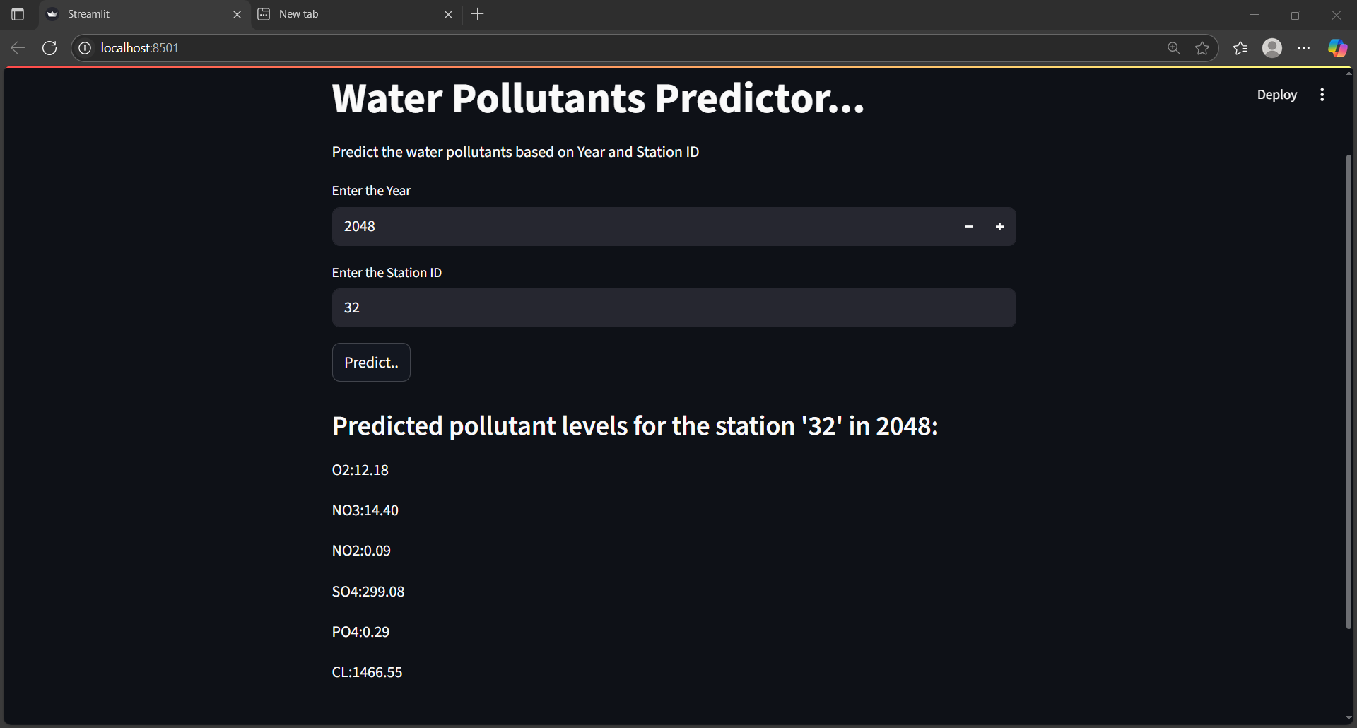
Screenshot of Output:

Slide 9
Conclusion:
In this project, we successfully developed a machine learning-based water quality prediction model using the Random Forest Regressor algorithm. We trained the model on chemical and biological water parameters such as O₂, NO₃, SO₄, NH₄, BOD5, CL, and PO₄, and achieved high prediction accuracy.
Future Scope:
Integrate real-time sensor data for dynamic and live predictions.
Deploy the model on the cloud or as a mobile/web application for public or government use.
Expand the model to include geographical location-based predictions.
Improve accuracy with deep learning models and larger datasets.
Assist in long-term environmental planning and public health monitoring up to the year 2100.
This model can be a valuable tool for environmental agencies, urban planners, and public health departments to ensure access to safe and clean drinking water for all.
GitHub:Manojya1701/Water_quality_prediction

